Slide 1
Python club session 4

Slide 2
Why you shouldn’t use AI to code while you are a beginner
You need the skills to comprehend what the AI is saying to you
Sometimes you reach a problem the AI cannot solve.. What then?
To use AI effectively you need to be able to articulate the problem and what exactly it is you want to do. This is fine when someone has written out the problem as an assignment, but in the real world you will have to articulate the problems yourself!

Slide 3
When it’s ok to use AI as a beginner
When you need something explained to you so that you can do it yourself

Slide 4
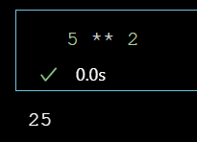
Power operator
In Python double asterix is the power operator
Like all operators this applies also to arrays

Slide 5
There are a few other operators but now you know the main ones

Slide 6
Numpy Arrays
A numpy array is a class which is useful for performing mathematical operations on an entire collection.

Slide 7
Don’t
Don’t make a file called numpy.py
If you do, when you try to import numpy in other files it will instead import the file you created…
Don’t make your file names the same names as libraries.

Slide 8
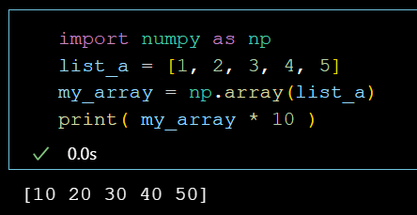
Operations
We can perform mathematical operations on arrays and single values

Slide 9
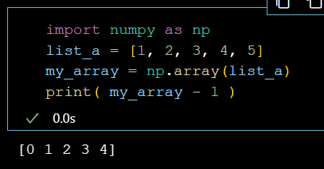
Operations
We can perform mathematical operations on arrays and single values

Slide 10
Task 1
Create a numpy array from a list with several numbers
Multiply that array with a single value
Subtract from the array a single value
Divide the array by a single value

Slide 11
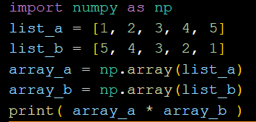
Operations
We can also perform mathematical operations on multiple arrays which have the same shape

Slide 12
Task 2
Create two arrays of the same shape
Try multiplying, dividing, and summing them

Slide 13
What is Array shape?
Lists are one dimensional, so they have a length
Arrays can be multidimensional, so they have a shape

Slide 14
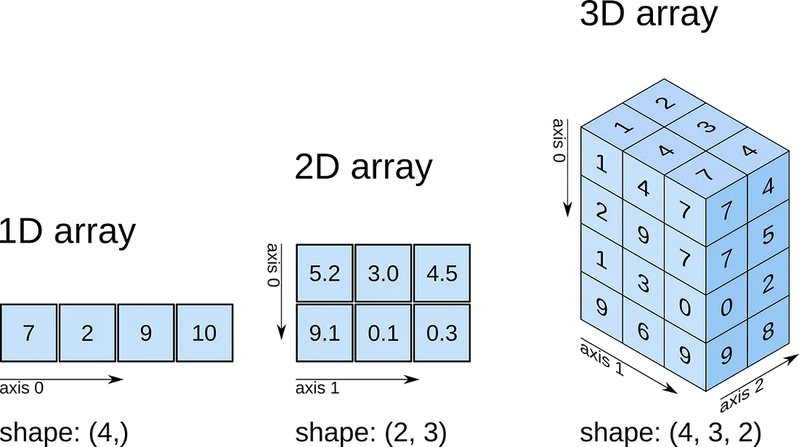
Creating a multidimensional array
A 2-dimensional array has columns and rows

Slide 15
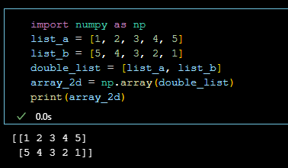
2D array
List of lists
Rows and columns
This array has 2 rows and 5 columns

Slide 16
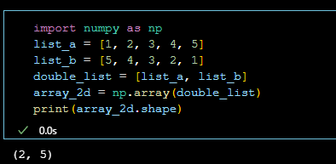
2D array
List of lists
Rows and columns
This array has 2 rows and 5 columns
Arrays have a property called shape

Slide 17
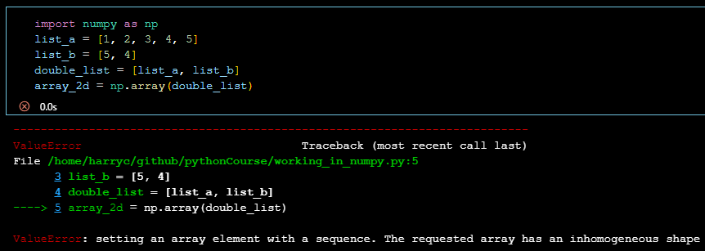
When creating an array all lists must be the same shape
If we combine two lists to create an array both must have the same length
If there are two lists there are two rows
There must be a constant number of columns

Slide 18
Task 3
Create a multidimensional array with a shape of your choosing
Print the array shape

Slide 19
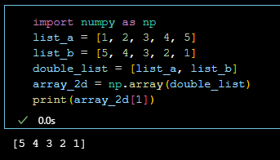
Array Indexing
[ first_dimension, second_dimension, third_dimension, etc ]

Slide 20
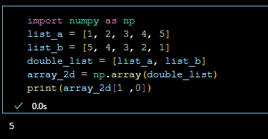
Array Indexing
[ first_dimension, second_dimension, third_dimension, etc ]

Slide 21
Task 4
Index into your array

Slide 22
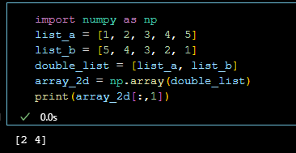
Range Indexing also works in Arrays

Slide 23
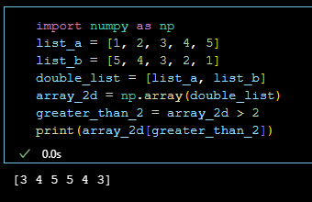
Array masking
You can mask arrays using Booleans to get all the values that meet a certain criteria

Slide 24
Task 5
Try different comparison operators to create different masks
Apply the masks to your array

Slide 25
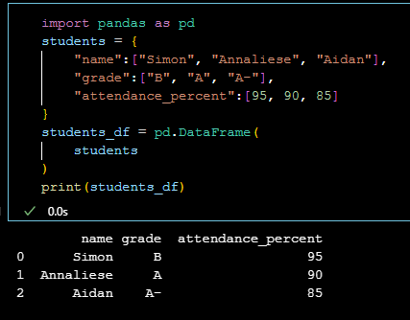
Pandas DataFrames
Like excel but for python
A pandas DataFrame is very similar to a dictionary

Slide 26
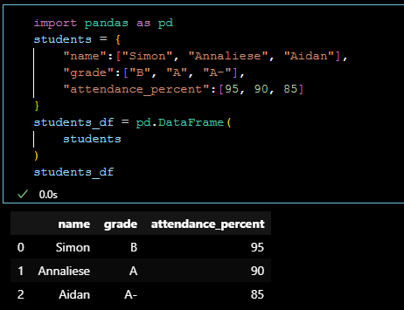
Formatting
If you don’t use print your output will still be displayed if it’s the last line that you run
In Jupyter this actually formats things nicer than print

Slide 27
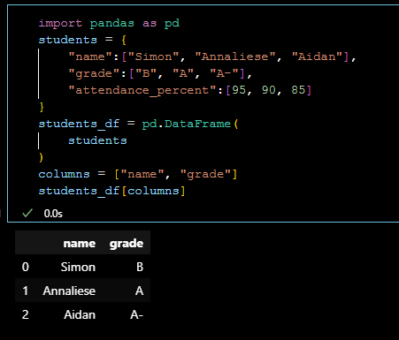
Pandas indexing
We can use a list of columns names to index multiple columns

Slide 28
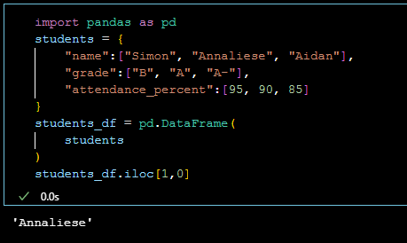
Pandas indexing
We can use iloc (integer location) and then this will allow us to index like a normal numpy array

Slide 29
Task 6
Create a pandas DataFrame from a dictionary
Index into multiple columns using a list
Use .iloc to index into specific places or ranges of values

Slide 30
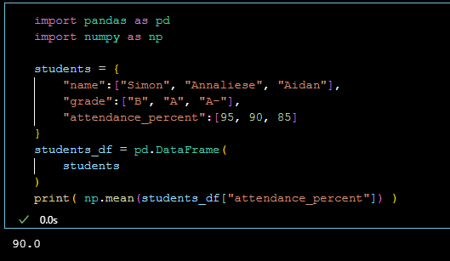
Pandas behaves very similarly to numpy
You can use numpy functions on pandas columns

Slide 31
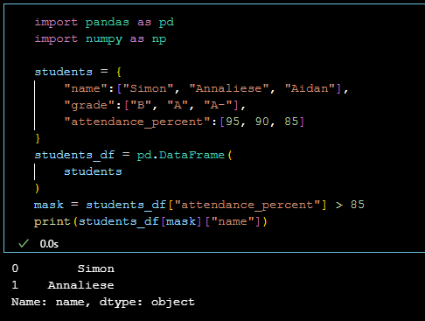
You can also mask pandas DataFrames

Slide 32
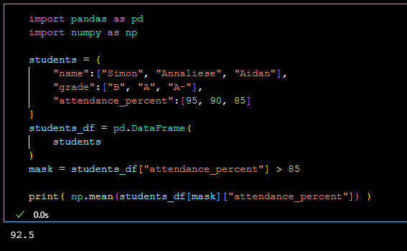
You can also mask pandas DataFrames

Slide 33
Task 7
Try masking your DataFrame

Slide 34
Reading a CSV file with pandas
Most data will be distributed as csv (sometimes excel)
If it’s in excel you will have to pip install an extra package (it will tell you which one when you try to open the excel file in pandas)

Slide 35
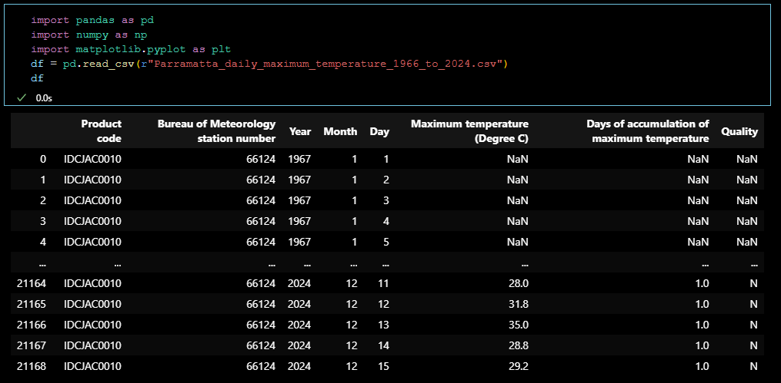
Reading a CSV file with pandas
The command to open a csv file is pd.read_csv()

Slide 36
Task 8
Use read_csv to open the file I sent you

Slide 37
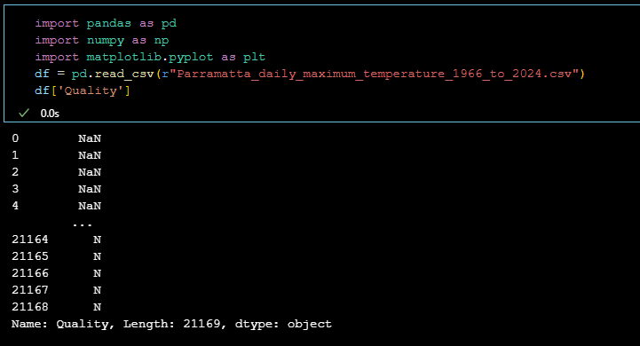
Data Cleaning
Let’s index into the Quality Column

Slide 38
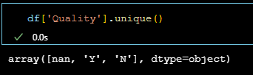
Data Cleaning
It’s more useful to see the unique values

Slide 39
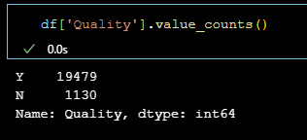
Data Cleaning
We can also see the total counts of each value though this ignores nans

Slide 40
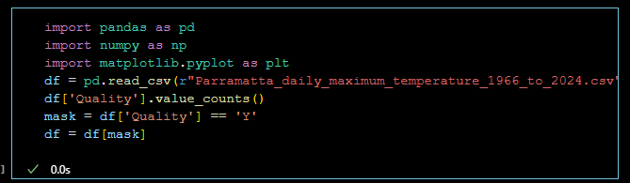
We can use masking to clean our dataset

Slide 41
Task 9
Use masking to keep only rows where Quality is equal to ‘Y’

Slide 42
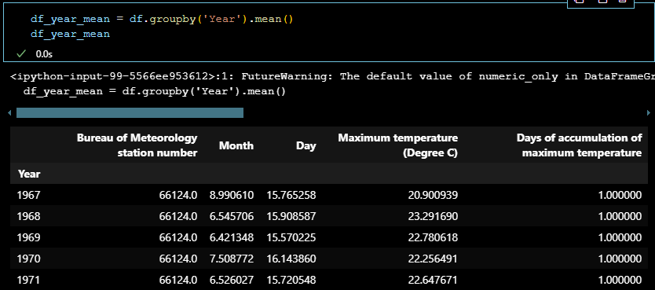
Groupby in pandas allows you to cluster your data based on a chosen column

Slide 43
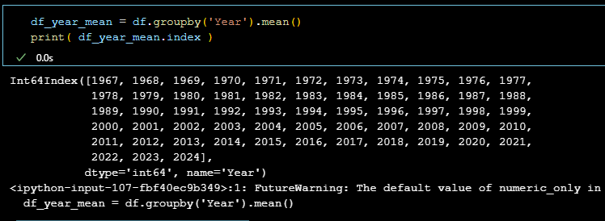
In the returned clustered DataFrame the value you chose to cluster on is the index

Slide 44
Task 10
Print the mean temperature per year using groupby

Slide 45
Plotting with matplotlib and seaborn

Slide 46
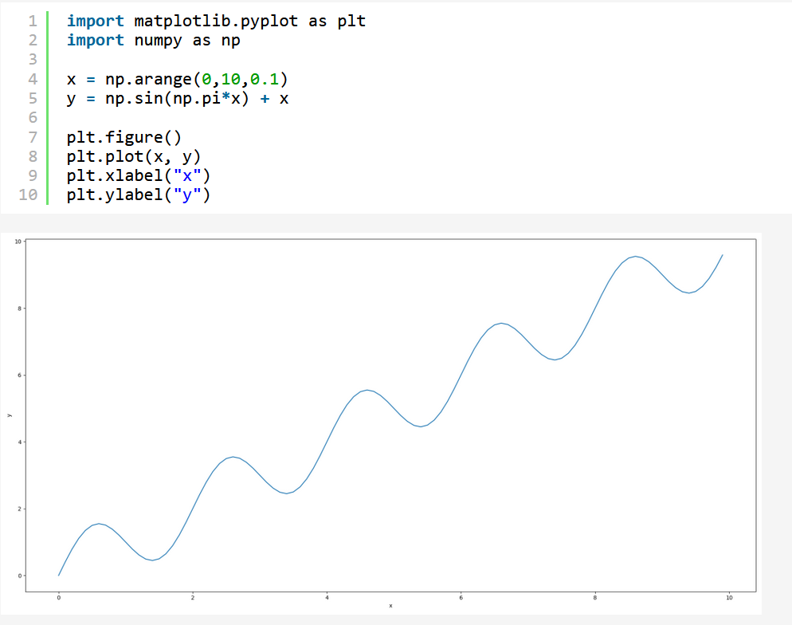
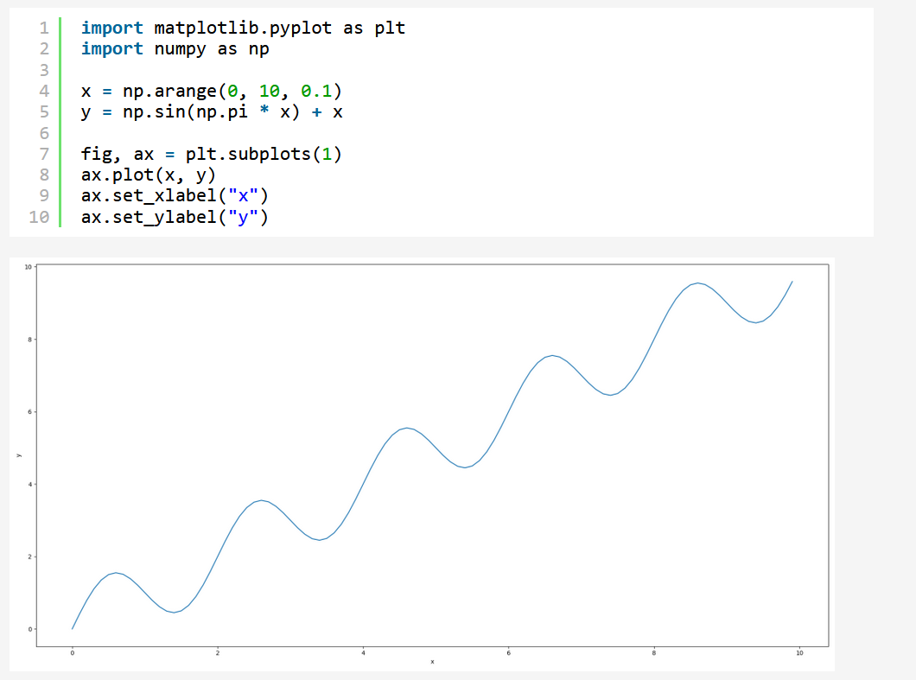
Matplotlib is the most popular plotting library in python
Creates Matlab like plots
Can be confusing as there are multiple ways of creating the same plot

Slide 47
Seaborn
A higher level library based on matplotlib
Looks prettier than MatPlotLib
Is easier than Matplotlib
Gives you less control

Slide 48
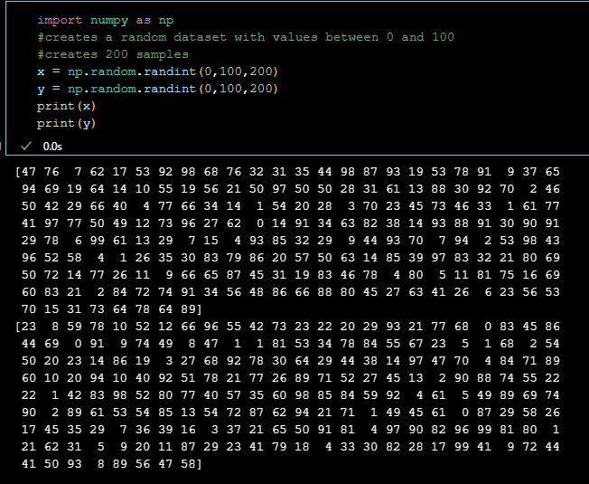
Generating random data in numpy
For plotting we may want to use random data points for testing purposes
We can do this with np.random.randint

Slide 49
Task 11
Create two variables x and y
each should be random numbers between two integers
They should have the same length

Slide 50
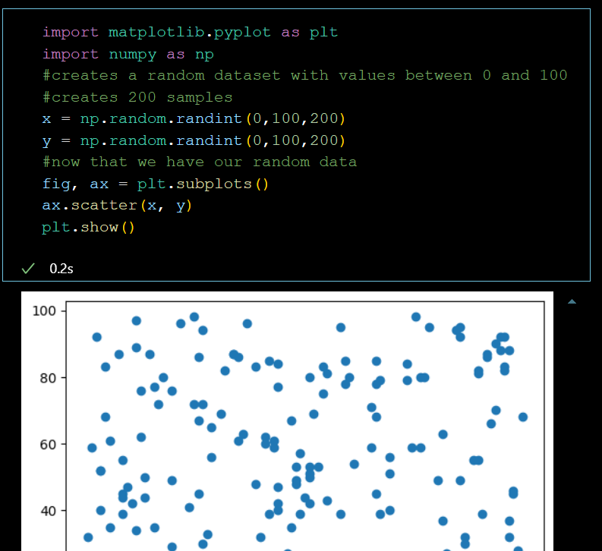
Using Matplotlib
We create a figure
We specify the type of plot. (in this case scatter)
We insert the data
We show the plot

Slide 51
Try to plot your random data in matplotlib
Try scatter, and plot

Slide 52
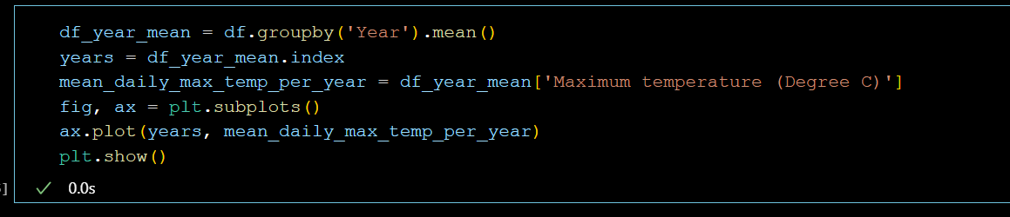
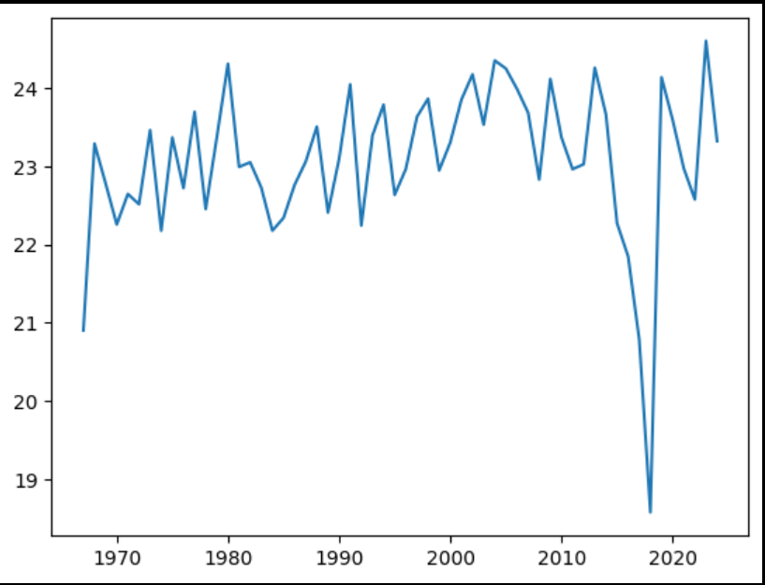
Plotting our climate data

Slide 53
Task 12
Plot the climate data
After you have made the plot cluster by ‘Month’ instead of ‘Year’

Slide 54
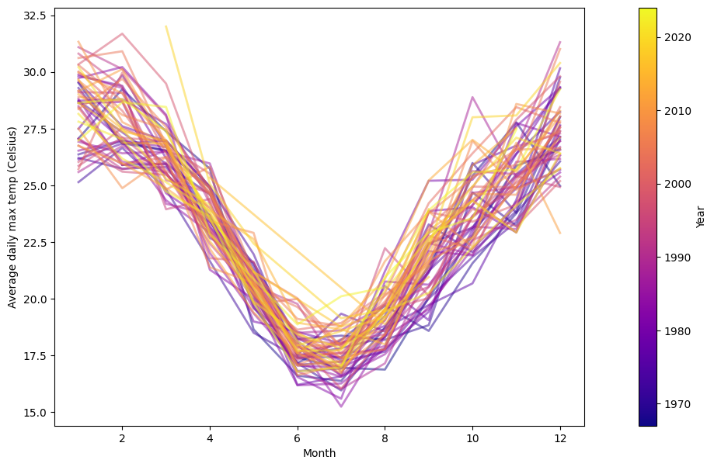
I tried to plot the data ☺

Slide 55
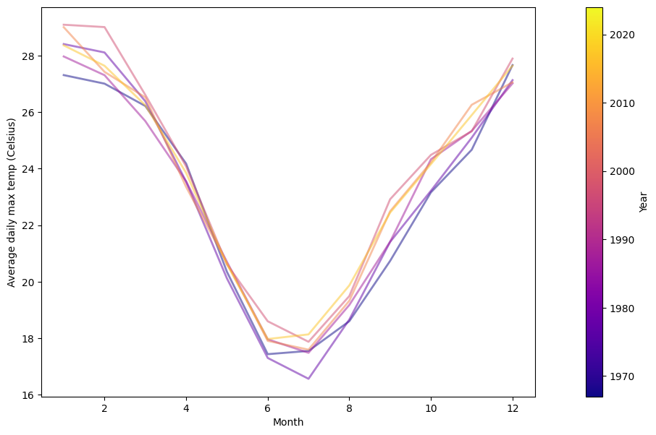
Then by decade average ☺

Slide 56
Assignment
Find the hottest average year for this dataset
Find the hottest month on record
Find the coldest average year for this dataset
Find the coldest month on recode
Try to make an interesting graph! Prize for the best one ☺
Email me your results

